Slide 1
Java and OOP

Slide 2
Key Topics
Programs and Memory
Compilation
Why Use Java?
Getting Started with Java
Modules
Packages
Classes
Methods

Slide 3
Programs and Memory

Slide 4
Programs and Memory
There are two ways a computer can store information:
Short-term memory:
Used for active programs and system processes
Faster access
Temporary (computer needs to be on)
RAM, CPU cache
Long-term memory:
Used for storage permanent data
HDD, SSD, flash drives, CDs, etc
When a program runs, any data it needs to create and use are stored temporarily, in RAM, until it stops executing.

Slide 5
Computer Memory Structure
CPU
Temporary Storage
CPU Cache
RAM
Permanent Storage- Hard Disk

Slide 6
Compilation

Slide 7
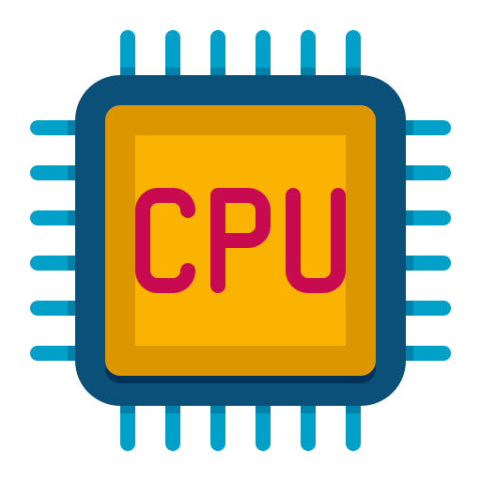


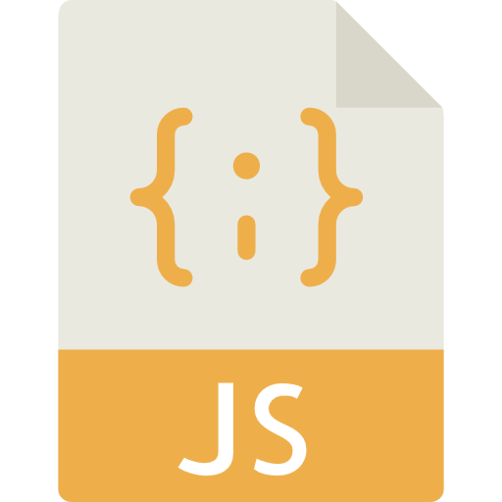
Compilation
Computer hardware runs on binary code
A processor is capable of assembling Assembly code into binary
So how do we get Assembly from Java? Compilation!
source code
assembly
binary
Notes:
Computer with Person icon from Monkik at flaticon.com JS Code icon from Smashicons at flaticon.com
Computer with Binary icon from Freepik at flaticon.com
CPU icon from Flat Icons at flaticon.com

Slide 8
The JDK, JRE, and JVM
JDK: The Java Development Kit is required to develop Java applications
this is what you installed when you “installed Java”
It contains a compiler and the JRE
The compiler converts Java source code into bytecode
JRE: The Java Runtime Environment is required to run Java applications
it contains the Java API
It contains the JVM
JVM: The Java Virtual Machine is an interpreter that executes Java programs
It takes in bytecode created by the compiler and translates and executes it into machine code

Slide 9
JDK, JRE, JVM Visualized
Source Code:
.java
javac command
JDK: Java Development Kit
JRE: Java Runtime Environment
Bytecode:
.class
JVM: Java Virtual Machine
JiT compilation
What the OS, operating system,
can actually understand

Slide 10
Why Use Java?

Slide 11
Why Use Java?
Platform independent:
“Write Once, Run Anywhere”
JVM compiles Java to bytecode. Bytecode works with any JVM, even if the underlying computer architecture of the computer running the program is different than the architecture where the program was originally written.
Safe and easy to learn:
No memory management in Java
Designed to be easier to use than lower level languages
Free
Object Oriented:
allows you to easily create modular, reusable code
Been around for a while:
Java has an incredibly rich library and frameworks

Slide 12
Getting Started with Java

Slide 13
Compile Time Errors
When compiling a program, the compiler will look for common problems, typos, or other mistakes in your code.
Missing semicolons
“Symbol not found”: a typo in a keyword, or a valid class couldn’t be found by the compiler
Code that could generate problems (exceptions) is not handled safely
The compiler will tell you the line on which the error occurs, or near it.
An IDE will usually catch these errors before compiling and warn you.

Slide 14

Object Oriented Programming
Object Oriented Programming: writing code in such a manner as to model real-world objects
Objects have state and behavior
State: properties or characteristics
Behavior: an action the object can do
state
behavior
on or off
color
name
walk
grab things
light up

Slide 15
OOP Project Structure
Java code is written as modules, packages, and classes instead of a list of instructions
Modules are groupings of packages
Packages are groupings of classes
Classes are blueprints for objects
Code is written within classes
One class is used to start program execution
This modular approach to organizing our project makes it easier to test, maintain, and refactor.
APPLICATION
modules
classes
packages

Slide 16
Modules

Slide 17
Modules
Java Platform Module System (JPMS)
Introduced with Java 9
Collection of associated packages, resources, and a module descriptor
Module descriptor specifies
Name of module
Dependencies
i.e. other modules that your module relies on
The packages available to other modules
And more…

Slide 18
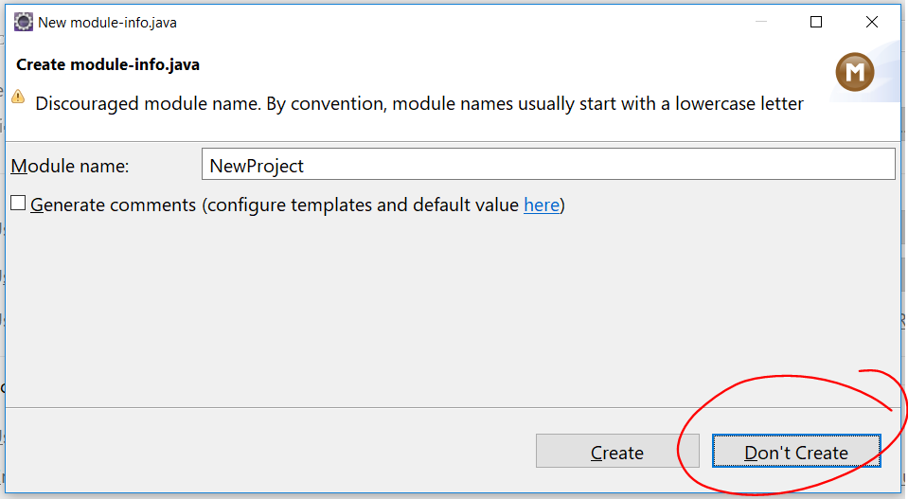
Module Descriptor
Created from module-info.java
module moduleName{
//module directives go in here
//technically all of these are optional
//you would specify things like
exports mypackage;
requires modulesNeededInModuleName;
}
For our purposes though you can simply select Don’t Create

Slide 19
Packages

Slide 20
Package Structure
Packages become nested folders used to organize our classes
com.revature.example → /com/revature/examples
Package declarations are used to specify which package a class is in
They must be the first statement in your class
if you don’t put a source file in a package, it goes into the default package
package syntax
folder path
package declaration
package com.Revature.example;
public class MyClass{
// other code here
}

Slide 21
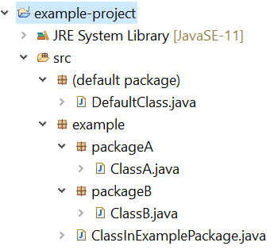
Packages Visual
It is not recommended to use the default package. Always create your own package and place classes inside!
ClassA is inside of packageA, which is inside of example
ClassB is inside of packageB, which is also inside of example

Slide 22
Classes

Slide 23
Classes
We write our code in classes
Classes are blueprints used to instantiate objects
Classes have state (variables) and behavior (methods) that are given to each object created from the class
Behaviors and states are shared across all instances of a class, but the values of variables may be different and can change
Example) Two people both have the name variable but the value for one person’s name is Bob, while the value of the other person’s name is Francis

Slide 24
Anatomy of a Class
Access Modifier class Class Name {
// variables and methods
}
Ex:
public class Dog {
// variables and methods
}

Slide 25
Executable Classes
A class with a specifically-declared main() method is executable
The JVM can invoke that method without creating an instance of the class first
This is the starting point of your application
An application usually only has one executable class
public class HelloWorld { public static void main(String[] args) { System.out.println(“Hello World!”); } }
an example of an executable class

Slide 26
Methods

Slide 27
Methods
A method is a block of code that runs when you call it
Can take in input
Can return a value
aka, a function!
When creating a method you use a more verbose syntax than with JavaScript
Java wants to know exactly what kind of method it is:
The type of data it takes in, if any
What it returns, if anything
If it belongs to the class*
Its level of access*
* Don’t worry about these last two things, we’ll go over them later!

Slide 28
Anatomy of a Method - Java
Access Mod Non-Access Mod Return Type Name (Parameters) {}
Ex:
public static void main (String[] args) {
system.out.println(“Hello World”);
}
protected float Add (float num1, float num2, String str) {
return num1 + num2;
}
public String print () {
return “Hello There”;
}

Slide 29
Putting It All Together

Slide 30

Example
Let’s say we were creating a program for an animal shelter – in this shelter we have a number of dogs. We want a program to model these dogs.
Each dog in our shelter has certain characteristics
Woof!
As well as certain behaviors like barking
name
weight
breed
age

Slide 31
Dog Class
Then we want to create a Dog class to model these characteristics and behaviors.
Our state or characteristics, name, weight, breed, and age, will be saved in variables and our behavior, barking, will be defined in a method.

Slide 32
Dog
NOTE: This class doesn’t actually run or do anything at all on its own.
It provides the code that would need to be used somewhere else in the program.
public class Dog {
String name;
double weight;
String breed;
int age;
public void bark(){
System.out.println(“Woof!!”);
}
}

Slide 33
Using the Dog class…
public class Dog {
String name;
double weight;
String breed;
int age;
public void bark(){
System.out.println(“Woof!!”);
}
}
Scruffy
Woof!
Daisy
public class TestDog {
public static void main(String[] args){
Dog daisy = new Dog();
daisy.name = “Daisy”;
daisy.bark();
Dog scruffy = new Dog();
scruffy.name = “Scruffy”;
}
}

Slide 34
Recall
What is Java?
What are the steps from writing Java code to running on the computer?
What are compile time errors?
What is Object Oriented Programming?
What are packages, classes, and methods?

